Slide 1
Supplier Performance Program
The views expressed by the presenter are solely the views of the presenter and do not necessarily reflect the views of General Atomics. General Atomics is not providing contractual direction and does not guarantee the accuracy of the data in this presentation and accepts no responsibility for any financial or other consequences arising from the use of such information. Any opinions or conclusions provided shall not be ascribed to General Atomics.

Slide 2
Supplier Performance Program
Agenda
Introductions
Session Overview
Program Primer
Measuring Performance
Growth & Maturation
Supplier Performance Corrective Action Board
Program Utilization
Program Enhancements
Customer Resources
Questions

Slide 3
Introductions
Welcome to General Atomics (GA) Supplier Day 2024.
The session presenter is Brian Garcia.
This session is moderated by Andrew Salceda and Vanessa Weber.
A short question and answer period will follow the presentation.

Slide 4
Introductions (cont.)
Brian Garcia has over 26 years experience as a strategic sourcing and supply chain leader in multiple industries and companies, such as Racal Pelagos, Thales, Callaway Golf, and Pentair. He holds a B.S. (Cellular & Molecular Biology) and M.B.A. (Information Systems Specialization) from San Diego State University and is a certified Six Sigma Black Belt (Breakthrough Management Group) and Supply Chain Professional certification (Association for Supply Chain Management). Brian has been with GA for over 11 years leading the GA Supplier Performance Program (SPP). In this capacity he has significantly increased participation in the SPP, upgraded the platform to the latest best practices and is continuously driving related supply chain improvement initiatives.

Slide 5
Introductions (cont.)
Natalie Garcia is a Supplier Performance Program Administrator supporting GA’s Supplier Performance Program (SPP). Natalie brings four years of focused aerospace and supply chain operations experience to GA. Natalie has earned a B.A. in English from San Diego State University and is currently earning an advanced graduate certificate in Contracts Management through San Diego State University.

Slide 6
Supplier Performance Program
Session Overview
Notes:
Sample slide is for each agenda topic or transition slide; similar slide should bridge each agenda topic area.

Slide 7
Supplier Performance Program
Session Overview
This session will provide a comprehensive overview of GA’s Supplier Performance Program (SPP). Session attendees will learn about the SPP, its purpose, development, and future opportunities. Key to this session will be explanations on performance metrics currently in use, how supplier performance is transparently measured and communicated via Performance Scorecards, and current customer resources. Highlights will also include an overview of GA’s Supplier Performance Corrective Action Board (SPCAB) and recent Supplier award recognitions.

Slide 8
Supplier Performance Program
Program Primer
Notes:
Sample slide is for each agenda topic or transition slide; similar slide should bridge each agenda topic area.

Slide 9
Supplier Performance Program
What is the GA Supplier Performance Program?
The objective of the Supplier Performance Program (SPP) is to transparently measure and report performance against GA Purchase Order (Order) requirements, including quality requirements, to assist GA Purchasing Representatives in identifying and selecting the most qualified Suppliers. Launched in 2008, the SPP serves as a key determinant in both competitive and non-competitive procurement decisions and continues to expand its membership to serve a growing and diverse supply base.

Slide 10
Supplier Performance Program
Measuring Performance
Notes:
Sample slide is for each agenda topic or transition slide; similar slide should bridge each agenda topic area.

Slide 11
Supplier Performance Program
Program Parameters
Driven by objective data and is GA’s recognized performance program
The GA SPP is benchmarked against industry peers & aligned with GA-ASI
Considerations
Score calculations remain consistent regardless of timeframe
All metrics and resultant scores are standalone, no weighting/averaging/blending
GA Purchasing Agents are a Supplier’s primary contact for performance issues
Delivery Tolerance; within means “On Time”:
-15/+5 working days on either side of the Statistical Delivery Date
Performance Classifications:
“Exceptional”: ≥98%
“Outstanding”: ≥95% - <98%
“Satisfactory”: ≥85% - <95%
“Unsatisfactory”: <85%

Slide 12
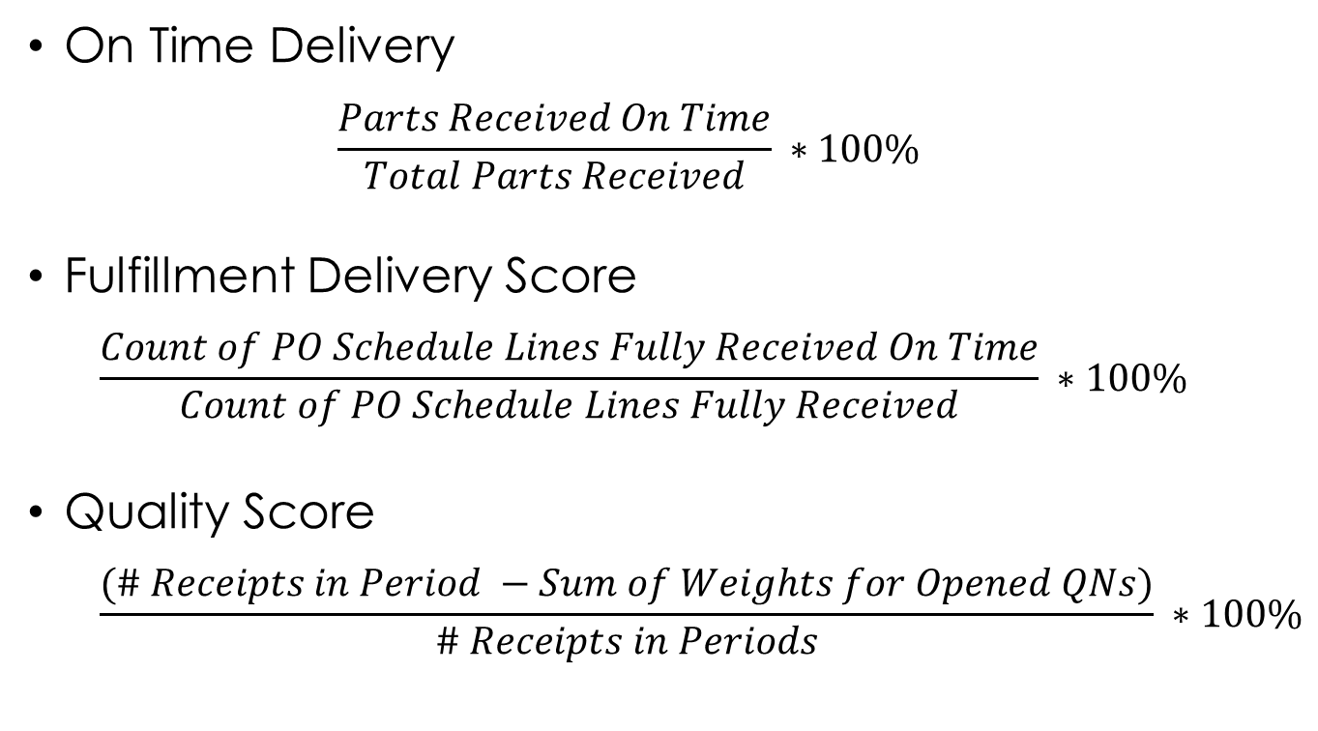
Supplier Performance Program
Objective Metrics
Calculations are straightforward and consistently applied to any performance timeframe.

Slide 13
Supplier Performance Program
Scorecard Attributes
Any metric scoring transaction activity for a Supplier on the SPP triggers the distribution of Monthly and Quarterly Performance Scorecards
Both Monthly and Quarterly Performance Scorecards share and include common key elements
Performance Period
Supplier Information
Recipient Contact Details
Metric Formulas
Metric Explanations
Performance Scores
Performance Classifications
Report Run/Refresh Date
Non-conformance Details
Monthly Inclusions
Quarterly Inclusions
All Delivery & Quality transaction details for any month with scoring activity.
All material Goods Receipts
Part & Line-Item Delivery status
Full purchasing details
Aging PO Items
Deemed “Late” had they been received
Quality Notification Details
Only non-conformance transactions during any given quarter.
Monthly & Quarterly scores/graphics
Quarterly transaction totals (e.g., # Deliveries, QNs)
Expanded Delivery analysis (e.g., Average Days Early/Late)
Rolling 12-month scores/graphics

Slide 14
Supplier Performance Program
Growth & Maturation
Notes:
Sample slide is for each agenda topic or transition slide; similar slide should bridge each agenda topic area.

Slide 15
Supplier Performance Program
Significant Milestones
After a successful pilot, the SPP expanded both scope and structure.
2007-2009
Developed supplier evaluation roadmap & identify SAP solution
Piloted 20 Suppliers and distribute first Supplier Performance Scorecards
Established SPP Governance Board, system enhancement, rolled out to organization
2010-2012
Updated program parameters following extended trend analysis
Expanded program breadth to include additional GA business units
Implemented Supplier Performance classifications and benchmarks
2013-2015
Identified first award candidates for top performing Suppliers
Created management dashboard to track long-term performance
EMS Supply Chain Council representation, 1st & 2nd Supplier Days
2016-2018
Introduced dynamic dashboard for individual Supplier trend analysis
Expanded membership, tightened operations, increased SPP staffing
Created internal program Performance Bulletins, 3rd & 4th Supplier Days

Slide 16
Supplier Performance Program
Significant Milestones
The SPP has steadily matured to become a core GA program.
2019-2020
Identified requirements, configured system, and tested custom platform
Considered default participant in GA audits (internal/external)
Revamped of Performance Scorecard language/layout for new metrics
2021-2022
New platform go live, increased report automation, 5th Supplier Day & 1st virtual
Began development of Power BI and revised offline dashboard offerings
First ever GA Supplier Award Luncheon, 6th Supplier Day & 2nd virtual
2023-2024
Introduce dynamic Power BI Performance Dashboards
Launch of Supplier Performance Corrective Action Board (SPCAB)
Second GA Supplier Award Luncheon, 7th Supplier Day, membership expansion
2025-2026
Enhanced Supplier Risk Analysis platform
Continued program development and membership growth
Inclusion of auxiliary metrics to begin inclusion of Service Suppliers

Slide 17
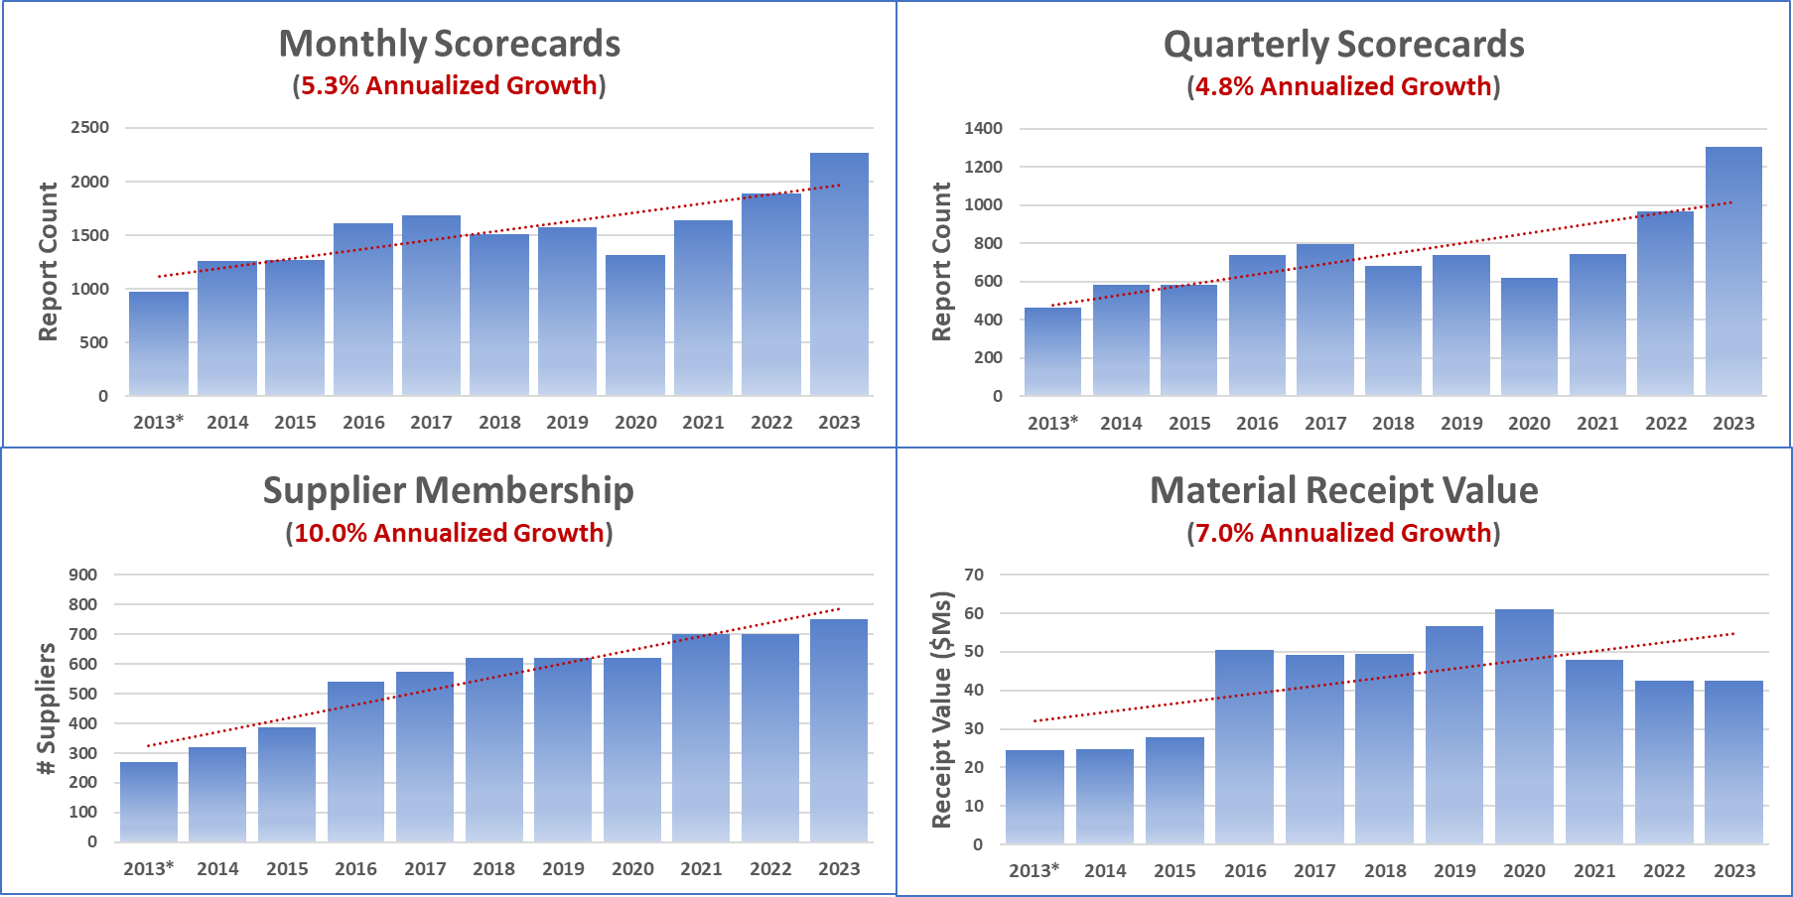
Supplier Performance Program
Program Expansion
The SPP continues to grow its coverage, contributions, and impact.

Slide 18
Supplier Performance Program
Supplier Performance Corrective Action Board
Notes:
Sample slide is for each agenda topic or transition slide; similar slide should bridge each agenda topic area.

Slide 19
Supplier Performance Program
SPCAB Overview
Mission: Address supply chain pressures, customer concerns, and affordability concerns by providing infrastructure and valuable data for stakeholders to effectively manage supplier performance
Vision: Mitigate risk within the supply base by monitoring performance assessments and developing risk mitigation strategies to support excellent supply base performance

Slide 20
Supplier Performance Program
SPCAB Process
The SPP extracts data monthly for selected key suppliers and provides it for the Governance Board’s review
Orders that have low performance classifications are highlighted and reviewed for corrective action
The SPCAB will investigate root cause, create and lead an action plan, and measure the progress
The action plans and their progress are reviewed during the SPCAB meetings

Slide 21
Supplier Performance Program
Program Utilization
Notes:
Sample slide is for each agenda topic or transition slide; similar slide should bridge each agenda topic area.

Slide 22
Supplier Performance Program
Over time the SPP has evolved to become an increasingly integral component of GA’s business and growth:
Supports Supply Chain Program Management and Strategic Supplier Management
Partners with GA and Suppliers to address performance issues through SPCAB
Crucial participant in both internal & external audits
Provides Supplier support and, as needed, advocacy
Core contributor for Supplier recognition and Supplier Day/Award events
Now completing its 16th year of operations

Slide 23
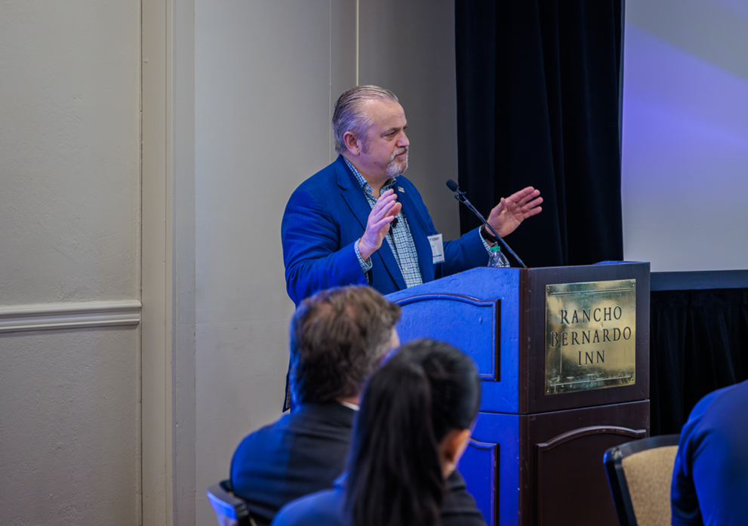
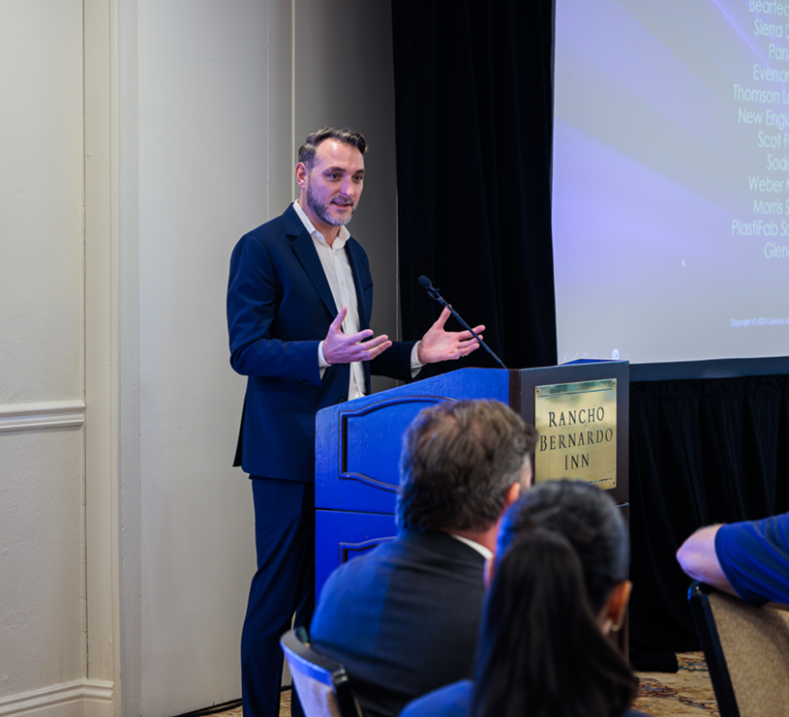
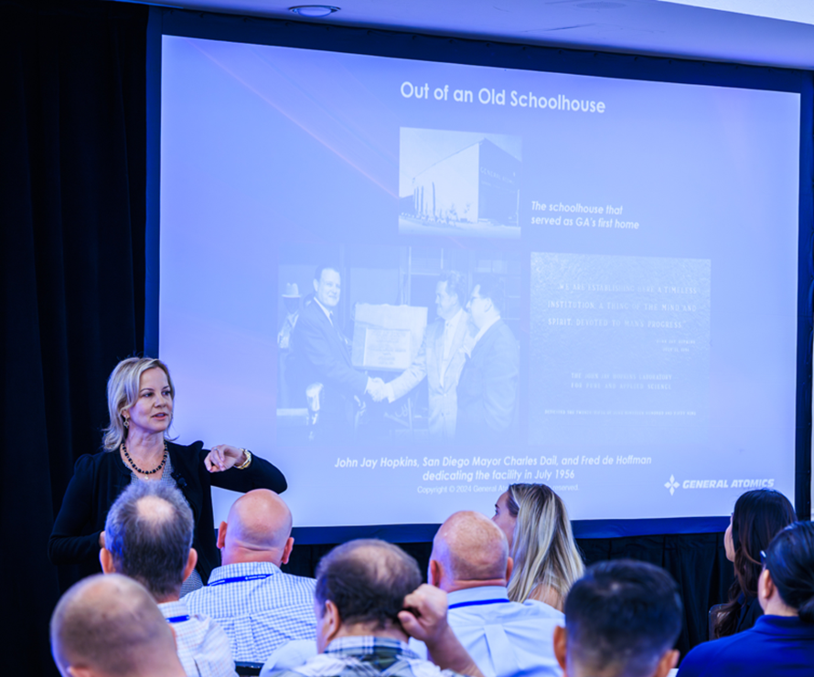
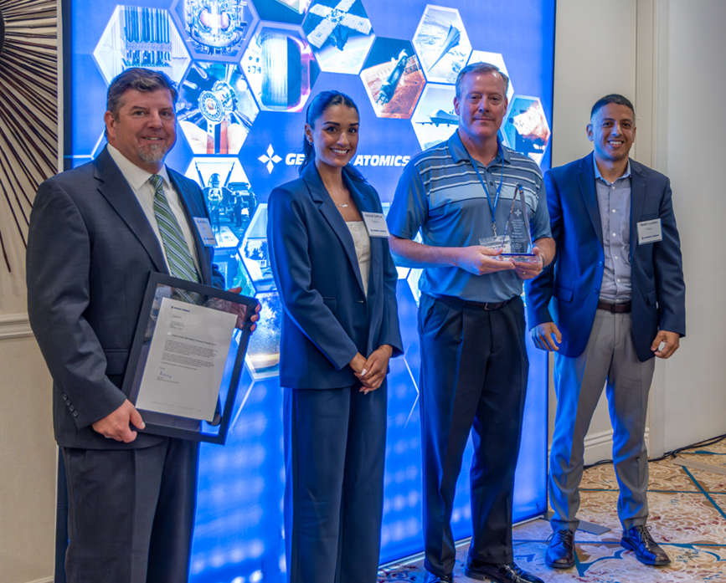
Supplier Performance Program
2024 Supplier Award Luncheon
GA was honored to host its 7th Supplier Award event recognizing multiple organizations for their consistently high performance and outstanding customer service. Congratulations to the awardees:
• Sierra Circuits • Beartech Alloys • Electrolock, Inc. • Parsons
• Everson Tesla • Thomson Lamination • Scot Forge • Sodern
• Weber Metals • Morris South • Plastifab • Glenair
• New England Wire Technologies

Slide 24
Supplier Performance Program
Program Enhancements
Notes:
Sample slide is for each agenda topic or transition slide; similar slide should bridge each agenda topic area.

Slide 25
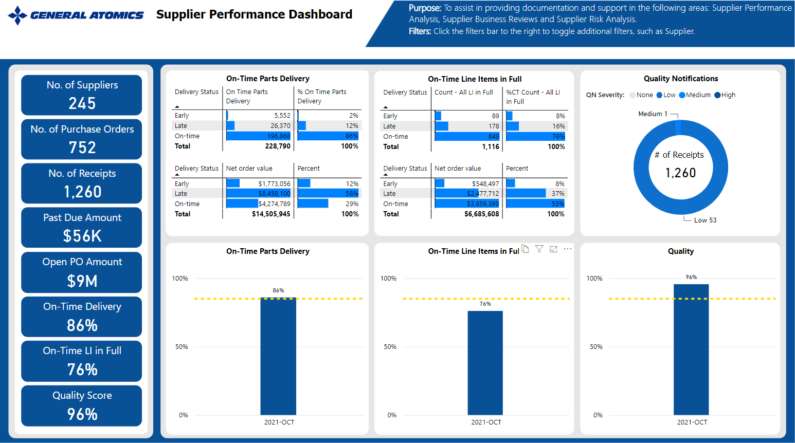
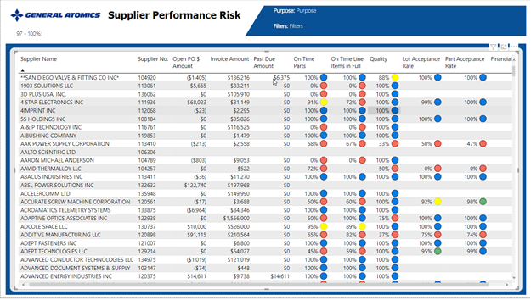
Supplier Performance Program
On The Horizon
Program enhancements for 2024-2025 largely established and on schedule.
Inclusion of virtually all Material Suppliers
Increase performance dashboard offerings
More granulated trend analyses
Identify internal improvement opportunities
Improve Supplier communications & involvement
Develop relevant metrics for Service Suppliers
Elevate the SPP role as business determinant
Improve Supplier recognition and promotion

Slide 26
Supplier Performance Program
Customer Resources
Notes:
Sample slide is for each agenda topic or transition slide; similar slide should bridge each agenda topic area.

Slide 27
Supplier Performance Program
Customer Resources
The SPP coverage spans all of GA Corporate and associated GA business units, save GA-ASI.
Multiple tools and resources are at the SPP’s disposal to assist as needed
Internal stakeholders and our valued Suppliers comprise our customer base; as such the SPP Team is always available:
Brian Garcia
Email: Brian.Garcia@GA.com | Mobile: (858) 239-9874
Natalie Garcia
Email: Natalie.Garcia@GA.com | Mobile: (858) 239-6572
SPP Administration
Email: SPP@GA.com or SupplierPerformanceProgram@GA.com
Website; Supplier Performance Program | General Atomics (ga.com)
Supplier Communications & Newsletter: Supplier Communications | General Atomics (ga.com)

Slide 28
Supplier Performance Program
Thank you
Questions?
Notes:
Sample slide is for each agenda topic or transition slide; similar slide should bridge each agenda topic area.

