Slide 1
Quality Matters
The views expressed by the presenter are solely the views of the presenter and do not necessarily reflect the views of General Atomics. General Atomics is not providing contractual direction and does not guarantee the accuracy of the data in this presentation and accepts no responsibility for any financial or other consequences arising from the use of such information. Any opinions or conclusions provided shall not be ascribed to General Atomics.

Slide 2
Introductions
Welcome to General Atomics (GA) Supplier Day 2024.
The session presenters are Matthew Stenson and Jose Alatorre.
This session is moderated by Chris Langer.
A short question and answer period will follow the presentation.

Slide 3
Quality Matters
Agenda
Introductions
Overview
GA Core Values
GA Quality Policy
Why is Quality Significant
GA Products and Technology
Powerful Partnership in Quality
QMS, AS9100, Risk Management, CAPA and GIDEP
Committing to Quality
Contacting GA
Questions

Slide 4
Introductions (cont.)
Matt Stenson spent the first 18 years of his life growing up in Great Falls, MT. Following in his Grandfathers’ footsteps, he joined the Navy, where he spent the 20 years of his life as a Submarine Nuclear Mechanic. After retirement in 2019 he joined the General Atomics team as a Nuclear Quality Engineer. In 2022 he assumed the position of Supplier Quality Manager of Inspectors.

Slide 5
Introductions (cont.)
Jose Alatorre is a Senior Quality Manager of Supplier Quality for General Atomics Quality Assurance organization. Mr. Alatorre is a dynamic professional with over 30 years of experience in High Tech and Defense Industries, with a particular focus on supplier development and qualification and supplier performance management. Mr. Alatorre has been a member of the GA QA team since 2019 and has implemented and Supplier Quality Engineering team that ensure that GA”s Supply Chain produces and delivers defect free products.

Slide 6
Doing Business with GA
Session Overview
Quality is not merely a function at General Atomics; it is a foundational pillar that drives innovation, enhances reputation, and ensures long-term success in both commercial and government sectors. Investing in quality translates to sustained performance and reliability in all products and services. Our suppliers play a crucial role in this commitment, as their expertise and best practices help enhance the quality of materials and components. By collaborating closely with suppliers and fostering a seamless supply chain, we can deliver superior value to our customers, ensuring greater satisfaction and trust in our offerings.

Slide 7
Quality Matters
GA Core Values
Notes:
Sample slide is for each agenda topic or transition slide; similar slide should bridge each agenda topic area.

Slide 8
Quality Matters
GA Core Values
We follow the letter and spirit of the law of the United States and all other countries in which we do business
We act with integrity and conduct our business to the highest moral, legal and ethical standards
We satisfy our customers by meeting our commitments and delivering high-quality, innovative, cutting-edge products and services
We treat one another with respect and take pride in each other’s contributions
We value our Suppliers by treating them fairly and recognizing their role in our success

Slide 9
Quality Matters
GA Quality Policy
Notes:
Sample slide is for each agenda topic or transition slide; similar slide should bridge each agenda topic area.

Slide 10
Quality Matters
GA Quality Policy
We are committed to developing, producing, delivering, and supporting products that meet or exceed the requirements of our customers
We continually improve our products and process through coordination with our customers, employees, and suppliers
We regularly review our quality objectives and assess risk associated with the Quality Management System to ensure that we maintain customer satisfaction and business focus
We maintain a dedicated, competent workforce and provide them with a safe work environment

Slide 11
Quality Matters
Why is Quality Significant?
Notes:
Sample slide is for each agenda topic or transition slide; similar slide should bridge each agenda topic area.

Slide 12
Why Quality Matters
Challenger Spacecraft
The failure to maintain high standards of quality directly led to the tragic disaster on January 28, 1986. The Challenger space shuttle exploded 73 seconds after liftoff, killing all seven crew members aboard. The disaster highlighted several critical issues related to quality control, engineering decisions, and organizational communication within the National Aeronautics and Space Administration(NASA)and its contractors.

Slide 13
Why Quality Matters
Challenger Spacecraft (cont.)
The primary cause of the disaster was the failure of an O-ring seal in one of the solid rocket boosters. The O-ring was not designed to function properly in the cold temperatures present on the day of the launch, which compromised its ability to seal the joint. This flaw was known to engineers, but the decision to launch was made despite concerns, reflecting a breakdown in quality assurance. the Challenger disaster is a poignant reminder of why quality, in all aspects—from engineering to decision-making and communication—is crucial in high-stakes environments like space exploration. The failure to uphold these standards can lead to catastrophic outcomes.

Slide 14
Quality Matters
GA Products and Technology
Notes:
Sample slide is for each agenda topic or transition slide; similar slide should bridge each agenda topic area.

Slide 15
Quality Matters
Products & Technology
Energy Systems and Products
Innovative nuclear and alternative energy solutions, with a focus on research needed for sustainable, alternative technologies that are safe and economical
Defense
Diverse portfolio of first-of-kind electromagnetic solution and product lines like aircraft launch and recovery systems, multi-mission railgun weapon systems, satellite systems, and integrated power and energy technologies are helping revolutionize the way military forces address complex challenges and protect against evolving threats
Commercial Products
Range of advanced technologies, such as Gulftronic® electrostatic separators, TRIGA® non-power nuclear reactor, diagnostic reagents and enzymes, deicing technology, high-power microwave, hazardous waste destruction, radiation monitoring systems, robotics and automation, and many others
Our history of powerful partnerships has been the foundation of mutual business success

Slide 16
Quality Matters
GA Expanding in Space
Several exciting programs in progress
TSIS-2 (Total and Spectral solar Irradiance Sensor)
EWS (Electro-Optical/Infrared Weather System)
Manhattan (Space to Space Laser Communications)
Many more classified programs
Space customers have extremely stringent quality requirements
Part selection (i.e., radiation, outgassing, survivability)
Environmental testing (i.e. Vibration, MOI, EMI/EMC)
Foreign Object Debris (FOD) prevention
Nonconformance / anomaly reporting
Preferred and prohibited materials
Achieving reliability and robustness in space is a significant challenge
OTB-1: Launched 2019
GAzelle: Launched Oct 7, 2022
EWS: Launching 2025
A robust quality management system is required to be successful

Slide 17
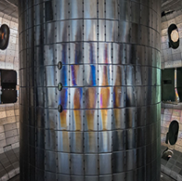
Quality Matters
Unique Quality Imperative Faced by Aerospace & Defense
The Aerospace & Defense (A&D) industry has recognized the crucial role of quality in the performance of aviation, space, and defense products for decades
GA continues to thrive in meeting and exceeding customer expectations.
There are no second chances in space, on board an aircraft carrier, or when operating a nuclear reactor
Industry favors and often requires unique A&D certifications and accreditations

Slide 18
Quality Matters
Powerful Partnership in Quality
Notes:
Sample slide is for each agenda topic or transition slide; similar slide should bridge each agenda topic area.

Slide 19
Quality Matters
GA Preference for Partners in Quality
Suppliers with Aerospace & Defense (A&D) industry certifications and quality-focused organizational participation
AS9100 certification
Risk Management Framework
GIDEP participation
Promote collaboration
Consistency (delivery and product acceptance “defect free”)
Efficiencies (process, cost, etc.)
Compliance (product requirements, regulatory, etc.)
Supports GA’s ability to maintain its own certifications and accreditations
You are critical to our continued success in existing and new frontiers!

Slide 20
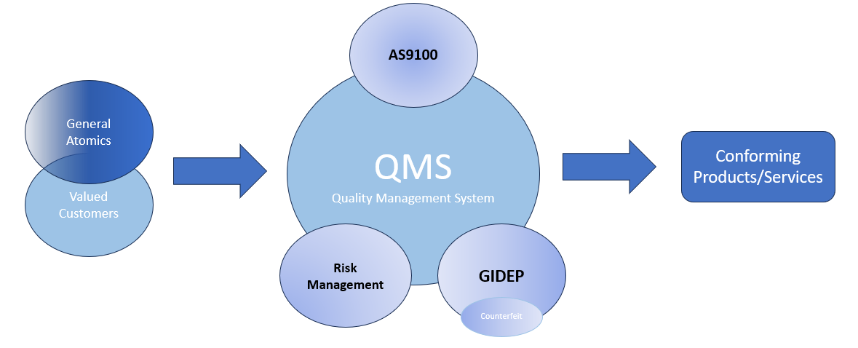
Quality Matters
Powerful Partnership in Quality
Our transformational technology opens the door for more and even stronger relationships

Slide 21
Quality Matters
QMS, AS9100, Risk Management, Corrective Action and Preventative Action (CAPA) and Government-Industry Data Exchange Program (GIDEP)
Notes:
Sample slide is for each agenda topic or transition slide; similar slide should bridge each agenda topic area.

Slide 22
Quality Matters
A&D Quality Management System (QMS)
Society of Automative Engineers(SAE) International Aerospace Standard 9100 – “AS9100”
“Quality Management Systems – Requirements for Aviation, Space and Defense Organizations” (current revision is AS9100D)
Created by the International Aerospace Quality Group (IAQG) in collaboration with representatives from aviation, space and defense companies worldwide
First released by Society of Automotive (SAE) in October 1999, replacing AS9000
Fully incorporates requirements of International Standards Organization (ISO) 9001
Adds 100+ requirements
Designed specifically for manufacturing and services companies in Aerospace sector
Satisfies quality requirements for multiple agencies, including:
Department of Defense (DoD)
National Aeronautics and Space Administration (NASA)
Federal Aviation Administration (FAA)
“AS9100 Certified” means an organization has met the requirements of AS9100 as certified by an independent certification body
General Atomics is proud to be certified to AS9100D

Slide 23
Quality Matters
Benefits of AS9100 Certification
Global recognition as a reputable supplier
Certification is recognized internationally and accepted throughout industry supply chains
Industry benchmark for sourcing suppliers
Access to large Original Equipment Manufacturers (OEMs)
All companies registered to an Aerospace standard are listed in the Online Aerospace Supplier Information System (OASIS) database
Product improvement
Process effectiveness
Customer satisfaction
An AS9100 certification offers many benefits, including more effective participation in the industry

Slide 24
Quality Matters
Risk Management
Important element of an effective Quality Management System
Understand, communicate, and manage risk to the achievement of objectives
Especially critical for Aerospace & Defense Industries
Nonconformances could result in loss of mission, serious injury, or loss of life
AS9100 Risk Management Requirements
“Plan, implement, and control the process for managing operational risks toward achieving all applicable requirements”
“Ensure QMS will achieve intended results and it will prevent or reduced undesirable effects.
Sub-tier supplier management (scope out your supply chain)
Cyber Security compliance
Identify and manage Key Risk Indicators
Risk management can prevent undesirable results that have serious consequences

Slide 25
Quality Matters
Continual Improvement
What is a nonconformity?
A failure to meet a customer, regulatory body, or your own organizational requirement
Corrective Action & Preventive Action (CAPA)
Requirement of ISO 9001 and AS9100
Elements:
Root Cause – identify direct cause to the failure.
Corrective Actions eliminate the cause of nonconformances and prevent reoccurrence
Prevent Actions prevent nonconformities, generally as a result of risk analysis
Both Corrective and Preventive Action can improve processes and lead to continual improvement
Helps avoids the cost of mistakes and potential loss of reputation
Continual improvement
Can improve processes, resulting in greater efficiency and lower costs
Can mitigate risk of nonconformances
A robust CAPA program can prevent costly mistakes and promote greater efficiency

Slide 26
Quality Matters
Government-Industry Data Exchange Program (GIDEP)
Cooperative activity between government and industry participants
Reduce or eliminate expenditures of resources by sharing technical information
Membership is free! Visit gidep.org today
FAR 52.246-26, Reporting Nonconforming Products (Nov 2021)
Included in GA’s standard terms and conditions for government contracts
Requires government contractors and subcontractors to screen for, report, and retain (until customer disposition) nonconforming items, including suspect counterfeit using GIDEP
Flow down to subcontractors:
Required for items subject to higher-quality standards; critical items; electronic parts or end items, components, parts, or materials containing electronic parts
Not required for subcontracts for commercial products and services
Participation in GIDEP is required under FAR 52.246-26 for DoD Procurements

Slide 27
Quality Matters
The Cost of Counterfeit Parts
Counterfeit parts have become a multi-billion- dollar industry
Technological advancements and increasingly global supply chain have made the threat even more likely
Comply with all regulatory requirements, quality standards, and best practices regarding counterfeit avoidance, detection, and reporting
Proactive focus on avoidance as opposed to just detection
Detection can be too late to avoid costly impacts
Schedule delays, rework, loss of reputation, potential loss of life
GIDEP membership provides access to industry reports and critical technical data
Helps avoid counterfeit issues before they materialize
Reporting to GIDEP is an important element of counterfeit part avoidance
Avoid the cost of counterfeit parts

Slide 28
Quality Matters
Committing to Quality
Notes:
Sample slide is for each agenda topic or transition slide; similar slide should bridge each agenda topic area.

Slide 29
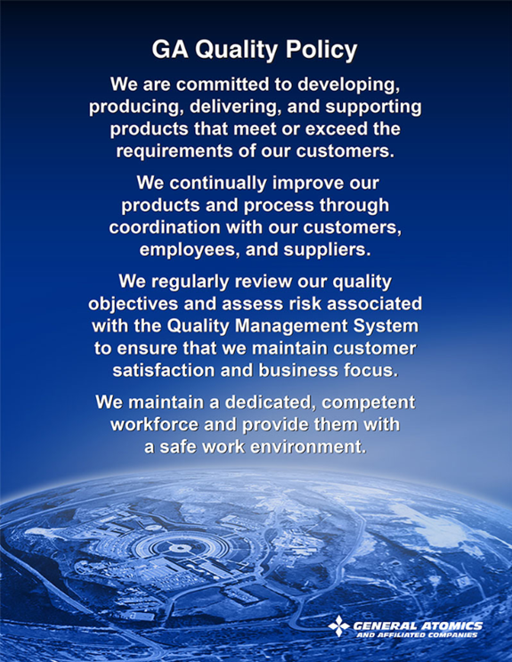
Quality Matters
Support our Quality Policy
Meet or exceed all PO requirements
We need your support to continually improve our products and processes!
Improvements you make to your products and processes have the potential to improve ours
Product compliance – delivery of product conformity documentation or OQE (Objective Quality Evidence)
Regularly review your quality objectives and assess risks associated with your Quality Management System
Maintain a dedicated, competent workforce and provide them with a safe work environment
https://www.ga.com/procurement/quality-policy
Your contribution to Quality Matters!

Slide 30
Quality Matters
Commit to Supporting GA’s Supplier Code of Conduct
GA’s Supplier Code of Conduct is posted at: https://www.ga.com/procurement/supplier-code-of-conduct
Includes GA’s Core Values
Includes many “Practical Commitments”, including:
“Quality Assurance”
“Employ quality assurance processes and best practices that conform to U.S. and international standards”
“Proactive identification of nonconformance and appropriate corrective action to ensure delivery of quality products or services that meet or exceed contract requirements”
Counterfeit Avoidance
Employ counterfeit electronic part detection and avoidance programs
Provide required documentation to authenticate reliability and conformity
Quality is a big part of our Code!

Slide 31
Quality Matters
What can you do to be a Powerful Partner in Quality?
Maintain a robust Quality Management System that includes effective Risk Management
Pursue A&D certifications and industry accreditation
Maintain a robust Counterfeit Prevention Program and participate in the Government-Industry Data Exchange Program (GIDEP)
Maintain a robust Corrective Action and Preventive Action (CAPA) program
Focus on Continual Improvement
Support our Quality Policy
Commit to our Supplier Code of Conduct
Contact us immediately with any quality, or product reliability or safety, concerns!
Our success depends on your commitment to Quality!

Slide 32
Quality Matters
Contacting GA
Notes:
Sample slide is for each agenda topic or transition slide; similar slide should bridge each agenda topic area.

Slide 33
Quality Matters
Contacting GA
Contact your Authorized Procurement Representative immediately to notify GA regarding any quality concerns
Utilize the Supplier Disposition Request (SDR) process to submit nonconformances (NCs) to GA Quality for disposition of NCs, including:
NCs that cannot be reworked to print
Needed design modifications
Clarifications of the drawing or specification requirements
SDR Forms are available on GA.com under “Procurement”, “Quality-assurance, “Forms”
Use EMS-0196 for GA Electromagnetic Systems Group (GA-EMS) Orders
Use GA-2329 for all other GA Orders

Slide 34
Quality Matters
Thank you
Questions?
Notes:
Sample slide is for each agenda topic or transition slide; similar slide should bridge each agenda topic area.

