Slide 1
Doing Business with GA
The views expressed by the presenter are solely the views of the presenter and do not necessarily reflect the views of General Atomics. General Atomics is not providing contractual direction and does not guarantee the accuracy of the data in this presentation and accepts no responsibility for any financial or other consequences arising from the use of such information. Any opinions or conclusions provided shall not be ascribed to General Atomics.

Slide 2
Doing Business with GA
Agenda
Introductions
GA website (www.ga.com)
Supplier Code of Conduct
Supplier Communications
Cybersecurity
Supplier Tools (Ariba & Docusign)
Quality Assurance Standards
Terms and Conditions
Certifications and Forms
Keys to Success

Slide 3
Introductions
Welcome to General Atomics (GA) Supplier Day 2024.
The session presenters are Justin Janich, Kasandra Moran and Melina Curatolo.
This session is moderated by Joshua Amante
A short question and answer period will follow the presentation.

Slide 4
Introductions (cont.)
Justin has over seven years of experience at GA in various roles. His academic experience includes a BS in Supply Chain Management from California State University, San Marcos, and an MBA from Florida State University. Previously, as part of GA’s purchasing compliance team, Justin facilitated all department-wide new hire training, supported Contractor Purchasing System Review (CPSR) audits, and served as an SME for topics such as supplier financing, Federal Funding Accountability and Transparency Act (FFATA) compliance. He is currently a GA Subcontract Administrator supporting DOE, DoD, OTA and commercial customers.

Slide 5
Introductions (cont.)
Kasandra Moran is a Buyer for GA’s indirect purchasing team. She graduated from California State University, San Marcos, in 2018 with a bachelor’s degree in Supply Chain Management; and is originally from San Diego, CA. She has held multiple roles in Supply Chain management from material planning, contracts and purchasing.

Slide 6
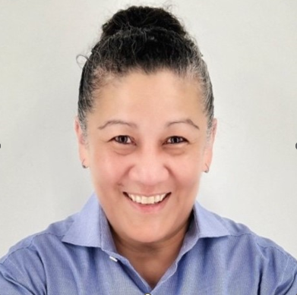
Introductions (cont.)
Melina joined GA in 2023 as the Systems and Infrastructure Manager for Contracts, Procurement and Proposals Management. She holds a B.S. in Computer Science and brings over 20 years of experience in technical leadership, customer success, and IT operations across the aerospace and software development industries. Melina is driven by a deep passion for solving complex business challenges, driving operational excellence, and contributing to organizational transformation. Witnessing the positive impact of enterprise change and the adoption of evolving technologies fuels her motivation to continuously align projects with long-term business objectives, promote efficiency, and foster collaboration, ultimately contributing to the success of the organization.

Slide 7
Doing Business with GA
Session Overview
Notes:
Sample slide is for each agenda topic or transition slide; similar slide should bridge each agenda topic area.

Slide 8
Doing Business with GA
Session Overview
This session provides a comprehensive overview of how to effectively engage and collaborate with General Atomics (GA). Participants will learn about our company's core values, procurement business processes, and key partnership strategies. The session covers essential topics such as procurement procedures, supplier communication protocols, cybersecurity, quality assurance standards, supplier tools (Ariba), terms and conditions, and certifications and forms.

Slide 9
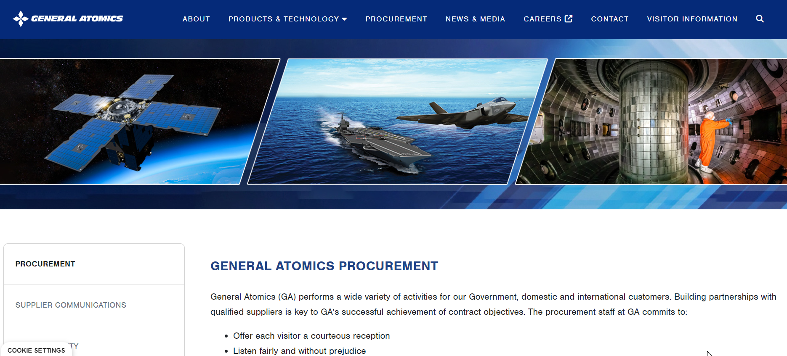
Doing Business with GA
www.ga/procurement.com
Notes:
Sample slide is for each agenda topic or transition slide; similar slide should bridge each agenda topic area.

Slide 10
Doing Business with GA

Slide 11
Doing Business with GA
Download our GA Supplier Code of Conduct

Slide 12
Doing Business with GA

Slide 13
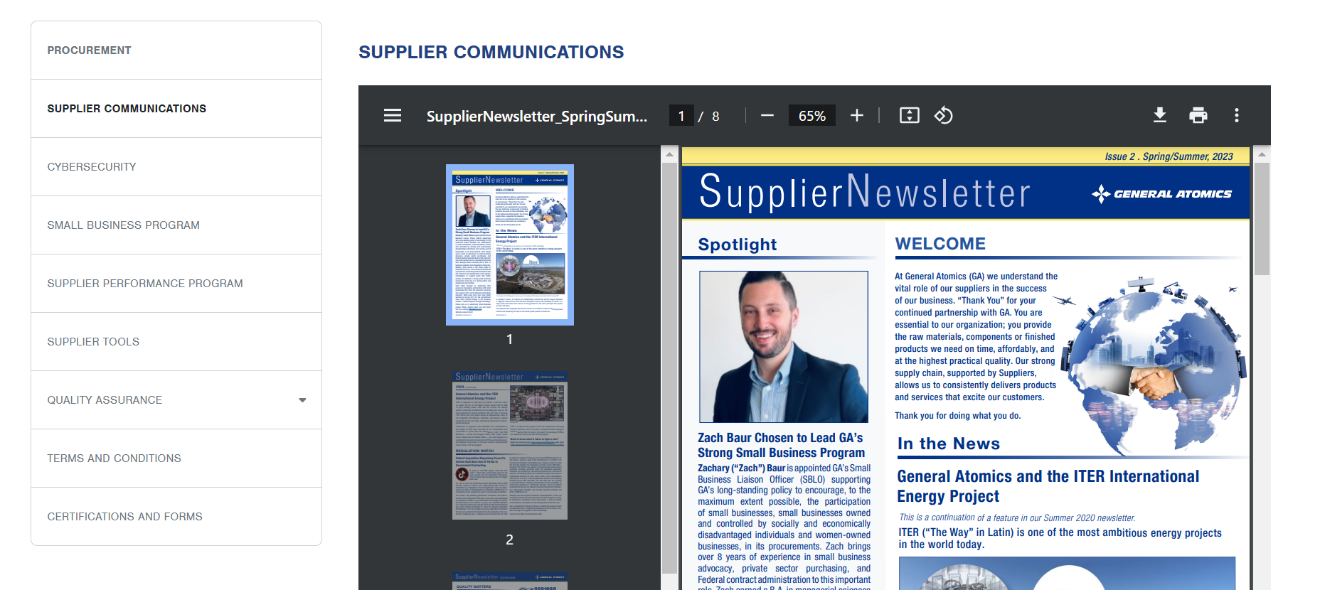
Doing Business with GA

Slide 14
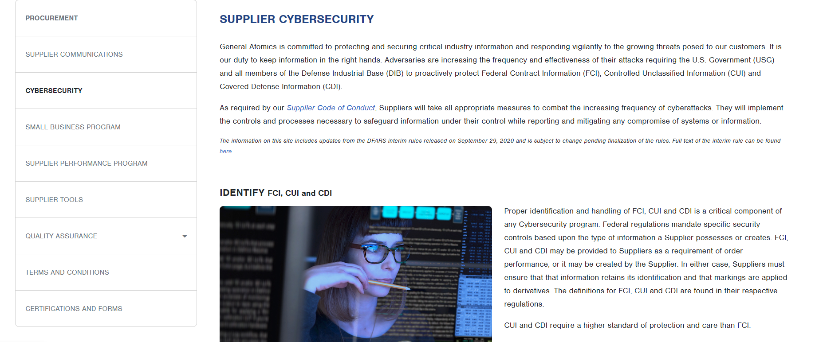
Doing Business with GA

Slide 15
Doing Business with GA
Cybersecurity – PROTECT Information, according to
National Institute of Standards and Technology (NIST) Special Publication (SP) 800-171
FAR 52.204-21 - Basic Safeguarding of Covered Contractor Information Systems
DFARS 252.204-7012 - Safeguarding Covered Defense Information and Cyber Incident Reporting
System Security Plan (SSP) – Free Template
DFARS 252.204-7020 - DoD Assessment Requirements
Cybersecurity – Report Cybersecurity Incidents
Notify your Purchasing Representative within 72 hours if you experience a Cybersecurity incident
If subject to DFARS 252.204-7012, must report incident to the DIBNet Portal within 72 hours of discover
Cybersecurity – Additional Resources and Video Training Resources
Project Spectrum
DoD Procurement Toolbox – Cybersecurity Resources
DoD – Office of Small Business Programs - Cybersecurity
DoD Official Controlled Unclassified Information Website
Video Training
DoD Controlled Unclassified Information Video Training

Slide 16
Doing Business with GA
www.ga.com/procurement
Notes:
On our GA website under Procurement, we have a couple supplier tools to help streamline the process of doing business with us.

Slide 17
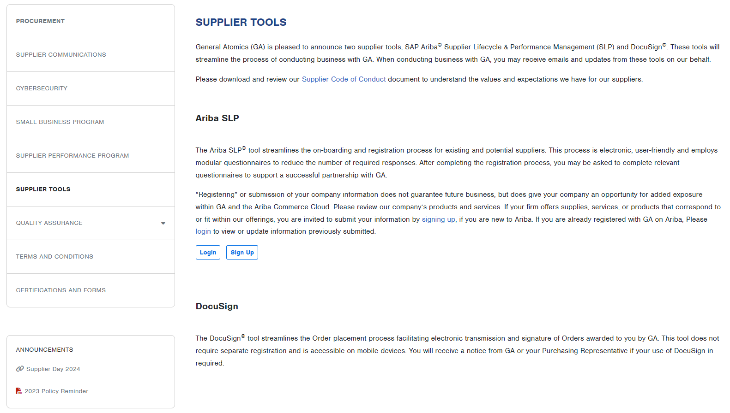
Doing Business with GA
Supplier Tools - Ariba
Notes:
Good morning everyone. It is great to be here at General Atomics Supplier Day to discuss one of our supplier tools, Ariba, our Supplier Lifecycle & Performance Management (SLP) tool.
Ariba's digital platform plays a critical role in our supplier onboarding and registration for existing and potential suppliers, enhancing transparency, compliance, and efficiency across our supplier ecosystem.
Our focus with Ariba is on creating an efficient, secure, and standardized onboarding and supplier registration experience for you.
By using Ariba, we ensure that each of you meets General Atomics compliance and regulatory standards from the very start, and maintains those standards while doing business with GA.

Slide 18
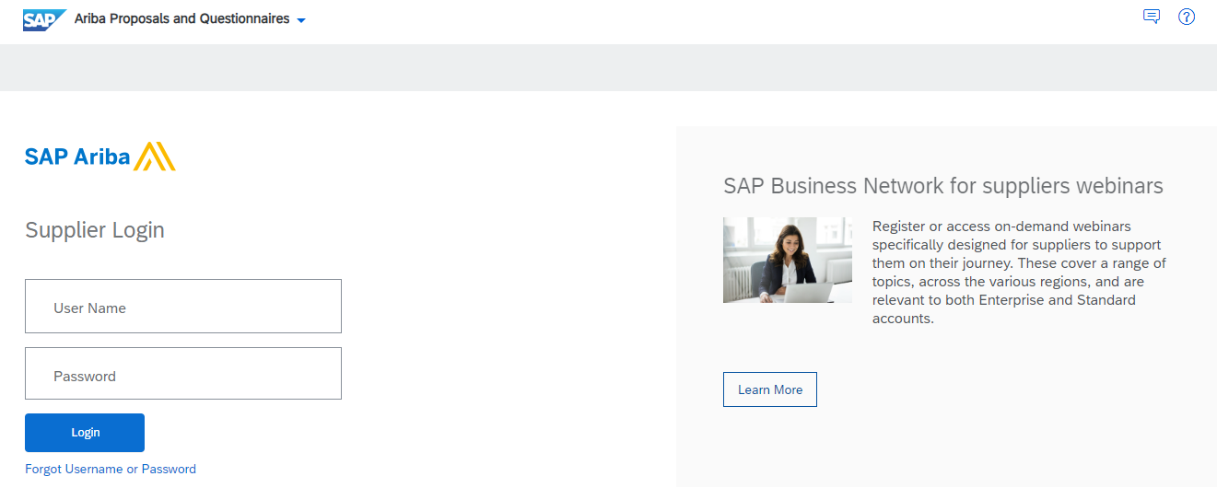
Doing Business with GA
Supplier Tools - Ariba
Streamlined Onboarding Process
Collect and verify information
Reduce onboarding time and administrative paperwork
Suppliers can upload documentation
Reviews and approvals without the delays of manual paperwork
Enhanced Compliance
Supplier information is centralized
Accessible as needed
Helps us maintain regulatory compliance
Reduce risks associated with incomplete or outdated information
Transparency and Communication
Real-time updates on the onboarding status
Establishes a solid foundation for future collaboration
proposals.seller.ariba.com
Notes:
Ariba benefits both GA and our suppliers in three major areas:
Streamlined Onboarding Process
Ariba allows us to collect and verify essential information efficiently, reducing the onboarding time and administrative paperwork for both parties
You can upload documentation and certifications directly in the system, and our team can review and approve them without the delays of manual paperwork
Enhanced Compliance
Ariba's centralized platform ensures supplier information is documented, stored securely, and accessible as needed, helping us to maintain regulatory compliance while reducing risks associated with incomplete or outdated information
Transparency and Communication
With Ariba, our suppliers receive clear guidance and real-time updates on the onboarding status, helping you track the progress and meet our requirements
This transparency not only fosters trust, but also establishes a solid foundation for future collaboration

Slide 19
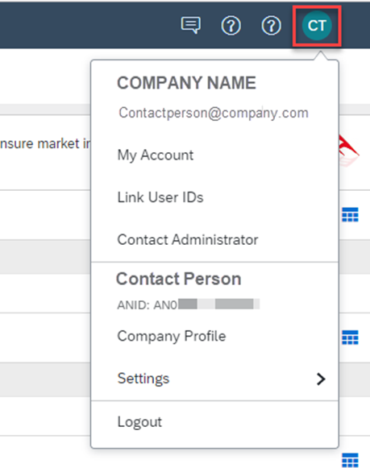
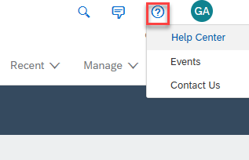
Doing Business with GA
Supplier Tools - Ariba
Account Administration
Account information
Company profile
Contact information
Support Options
Ariba Help Center
Your internal Ariba admin or IT department
Assigned GA purchasing representative or buyer
Ariba direct customer support
Notes:
The simple interface allows you to manage your account information, including your company profile.
If you need help with Ariba:
There is a wealth of information on the Ariba Help Center
You can contact your internal Ariba admin or IT department
Reach out to your assigned GA purchasing representative or buyer
Or contact Ariba customer support directly

Slide 20
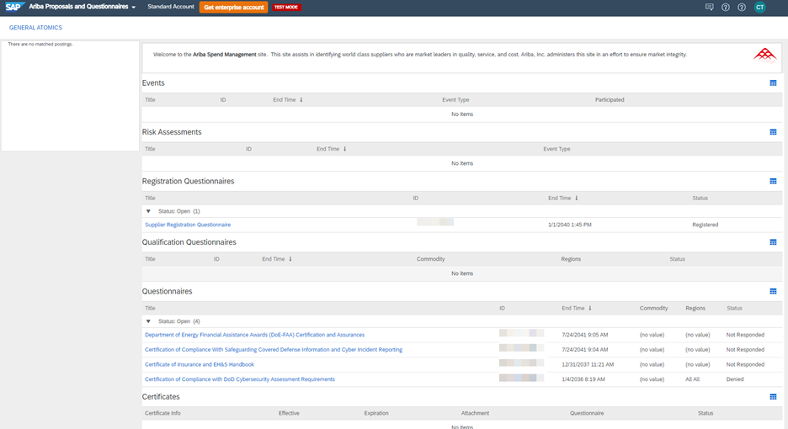
Doing Business with GA
Supplier Tools - Ariba
Dashboard Overview
Multi-Customer Access Use Ariba for multiple clients, not just GA, streamlining your processes
Comprehensive Dashboard View data for all your customers currently collaborating with you on Ariba
Event Visibility Your GA dashboard displays events that we have invited you to
Notes:
Multi-Customer Access
Ariba offers the flexibility to manage multiple clients from a single platform, not just GA. This feature streamlines your processes and saves you time by eliminating the need to switch between different systems.
Comprehensive Dashboard
The dashboard provides a comprehensive view of all your customers who are currently collaborating with you on Ariba. This visibility allows you to track interactions and manage tasks efficiently, ensuring you never miss important updates.
Event Visibility
When you navigate to your GA dashboard, you’ll see a list of events that we’ve invited you to. This centralized information helps you stay organized and informed about important activities related to your partnership with GA.

Slide 21
Doing Business with GA
Supplier Tools - Ariba
Supplier Registration Questionnaire
Collects essential company information
Completed by all suppliers
Additional Questionnaire Examples
Certification of Compliance with DoD Cybersecurity Assessment Requirements
Certification of Compliance with Safeguarding Covered Defense Information and Cyber Incident Reporting
Certificate of Insurance and EH&S Handbook
Export Control Compliance Certification
US Government Representations and Certifications - Domestic and Foreign Suppliers
Notes:
Supplier Registration Questionnaire
The Supplier Registration Questionnaire is a crucial step in our onboarding process. It collects essential company information and must be completed by all suppliers.
Additional Questionnaire Examples
In some cases, you may be required to complete additional questionnaires. These include important certifications, such as Compliance with DoD Cybersecurity Assessment Requirements, or Compliance with Safeguarding Covered Defense Information and Cyber Incident Reporting
Other examples include the Certificate of Insurance and the EH&S Handbook, as well as Export Control Compliance Certification. Each of these documents helps us gather necessary information to mitigate risks effectively.
Purpose of Additional Questionnaires
By collecting this additional information, we can make informed procurement decisions that align with our specific needs and compliance requirements. This process ultimately strengthens our partnerships and ensures regulatory adherence.

Slide 22
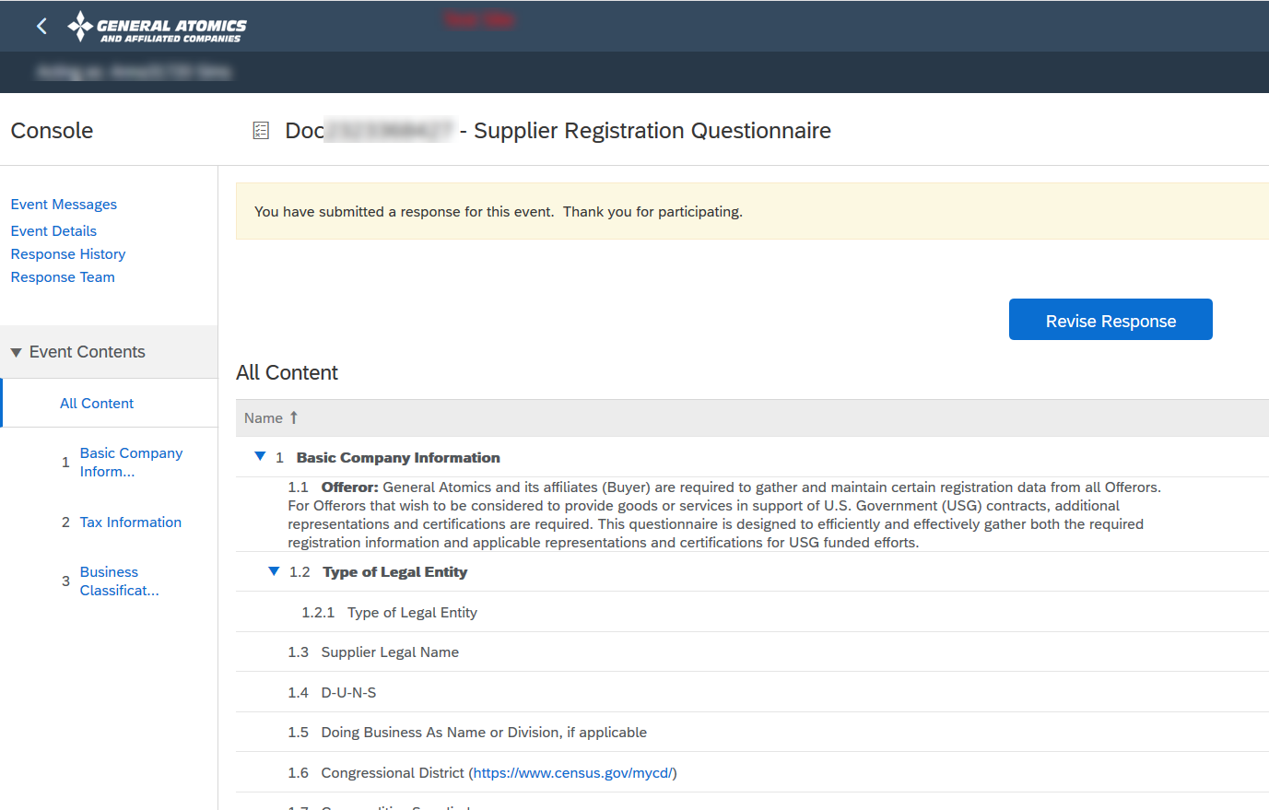
Doing Business with GA
Supplier Tools - Ariba
Digital Questionnaire Benefits
Consistent design and user-friendly interface enhance the supplier experience
Modular questionnaires allow tailored questions to minimize required responses, improving efficiency
Standardized questions ensure compliance with our requirements
Real-time email updates facilitate seamless communication between suppliers and GA representatives
Reduces manual paperwork, streamlining processes and enhancing overall efficiency
Cuts down onboarding time, allowing for quicker supplier engagement
Notes:
Having reviewed the different types of questionnaires we use for supplier onboarding, let’s look at how our digital questionnaires enhance this process and the benefits they bring to both suppliers and our organization.
One of the first things you’ll notice is the intuitive and user-friendly interface. This consistency helps you navigate easily, making the onboarding process smoother.
Our modular questionnaires adjust based on your responses, allowing you to skip irrelevant questions. This approach minimizes the number of required responses, improving efficiency while ensuring we collect the most relevant information.
Standardization is key for us. By using standardized questions, we can ensure that you meet our compliance requirements, which simplifies the vetting process and mitigates risks.
With real-time email notifications, both you and our internal teams stay informed about any updates or required actions. This constant communication helps prevent delays and keeps the onboarding process on track.
By digitizing our questionnaires, we significantly reduce the amount of paperwork involved. This not only streamlines our processes but also minimizes errors that can occur with manual entry.
Ultimately, all these benefits lead to a shorter onboarding time. This means we can engage with you faster, leading to improved collaboration and quicker delivery of products or services.

Slide 23
Doing Business with GA
Supplier Tools - Ariba
Our goal with Ariba is to drive efficiency, compliance, and security across our partnerships, ultimately ensuring that we can deliver cutting-edge technology together.
Notes:
Our goal with Ariba is to drive efficiency, compliance, and security across our partnerships, ultimately ensuring that we can delivery cutting-edge technology together.
For those of you already working with us, thank you for your continued dedication to improvement and excellence.
Let's keep moving forward together!
Next up is Kasandra who will be going over DocuSign, another tool we use at GA.

Slide 24
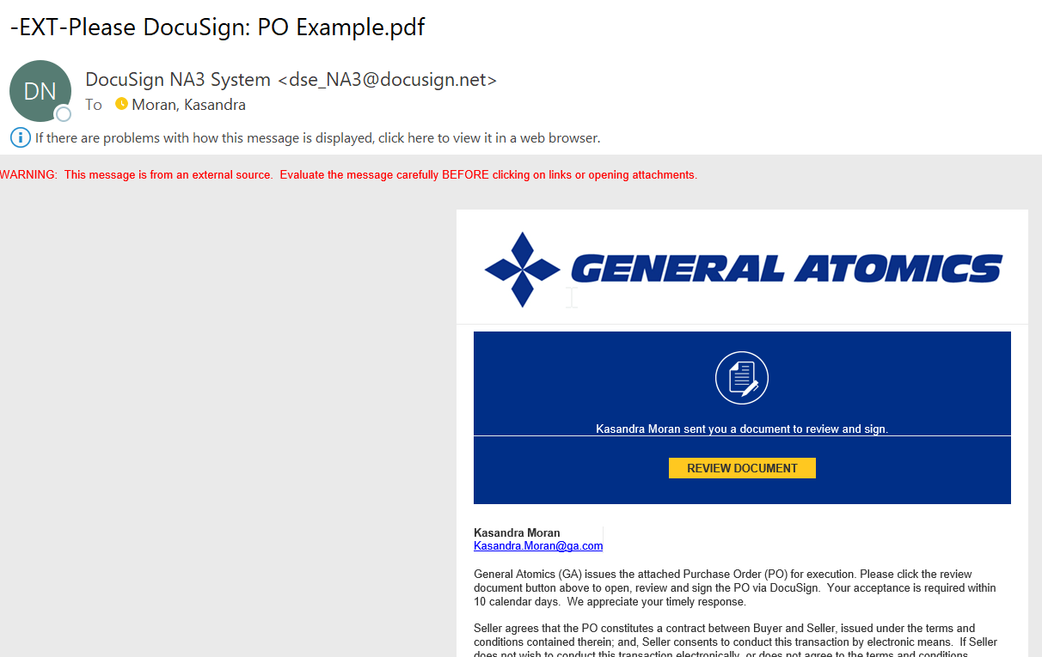
Doing Business with GA
Supplier Tools - DocuSign
How do Suppliers know if Docusign is required?
Notice from GA or Purchasing Representative if use of DocuSign is required
Suppliers receive an email as shown
Value of Docusign for GA & Suppliers
Helps streamlines Order placement
No registration required
Accessible on mobile devices
Notice from GA or Purchasing Representative if use of DocuSign is required

Slide 25
Doing Business with GA

Slide 26
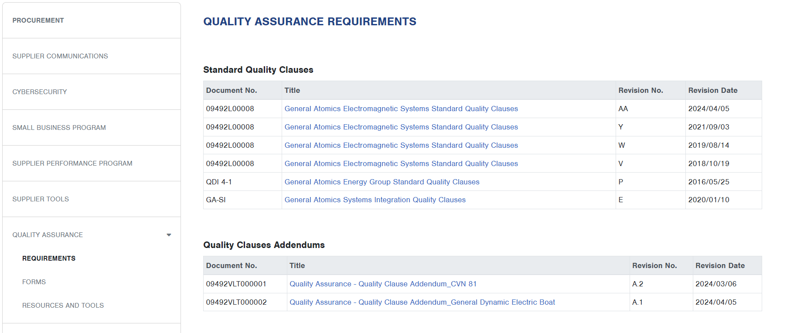
Doing Business with GA

Slide 27
Doing Business with GA
Quality Assurance – Forms
MIC Mark Package Summary (EMS-0282)
Source Inspection Request (EMS-0538)
Supplier Certificate of Conformance Form (GA 4031)
Supplier Document Reuse and Duplication Request Form (EMS-0364)
Welder Summary Form (EMS-0365)
Supplier Disposition Request Forms
Supplier Disposition Request, EMS (SDR EMS-0196)
Supplier Disposition Request, GA (SDR GA-2329)

Slide 28
Doing Business with GA
Quality Assurance – Resources & Tools
Continuially improve our products and process though coordination with our Suppliers
Contact your GA Purchasing Rep for any questions specific to your GA order
Supplier Quality Clause Awareness Resources
QC 259, 259b, 277 – Raw Materials and Metals Requirements
QC 273 & 275 – Welding and Brazing Requirements
For any questions regarding these resources, or to suggest training on specific QA topics, please contact us at: SM-QA@GA.com

Slide 29
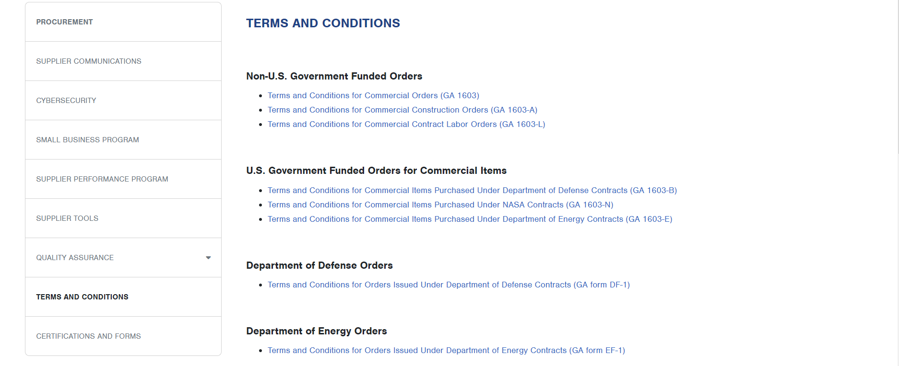
Doing Business with GA

Slide 30
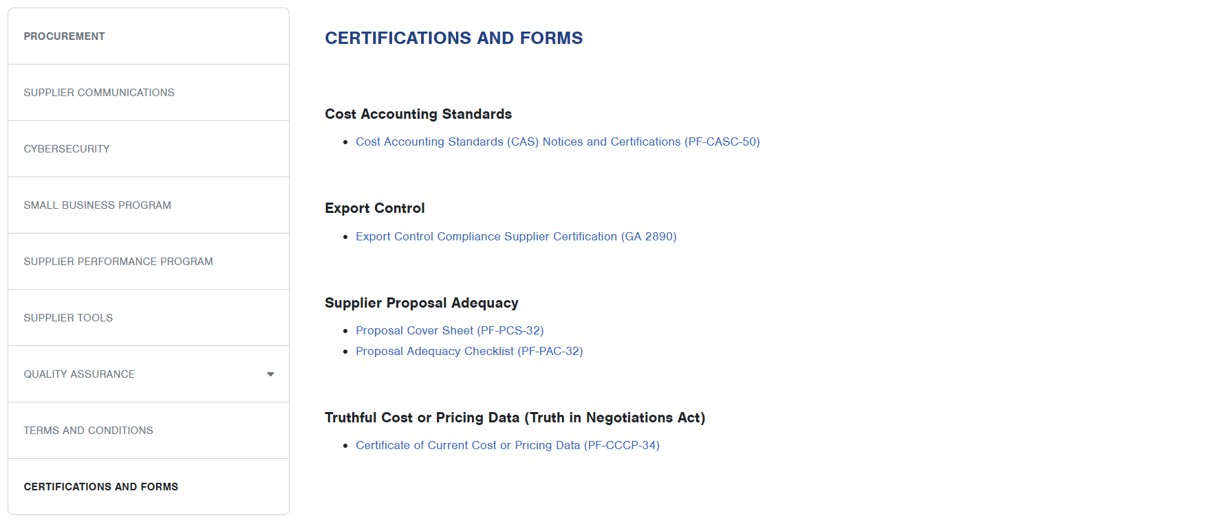
Doing Business with GA

Slide 31
Doing Business with GA
Key to Success
Notes:
Sample slide is for each agenda topic or transition slide; similar slide should bridge each agenda topic area.

Slide 32
Doing Business with GA
Keys to Success
Communicate proactively; provide regular Order Updates
Keep GA apprised and aware of any changes to your performance or operations
Notify Promptly of Personnel Changes
Facilitates continuity in communication, trust, and service quality.
Helps prevent confusion and allows GA Buyers to inform new personnel of our processes.
Be Responsive
Accurate and timely quotes or proposals help buyers make informed decisions faster and build trust.
Collaborate Effectively
Allows Suppliers of all sizes to provide valuable insights, solve potential issues proactively, and adapt solutions to changing business needs.

Slide 33
Doing Business with GA
Thank you
Questions?
Notes:
Sample slide is for each agenda topic or transition slide; similar slide should bridge each agenda topic area.

